Slide 1
Revenue forecasting using LSTM Neural Network
Igor Levecharov

Slide 2
Agenda
LSTM recurrent neural networks
Why to use LSTM
Primary goals
Experiments
Next steps

Slide 3
LSTM recurrent neural networks
LSTM stands for Long short-term memory. LSTM cells are used to predict the future from sequences of variable lengths. The main idea behind LSTM cells is to learn the important parts of the sequence seen so far and forget the less important ones. This is achieved by the so-called gates:
A compact representation of the time series seen so far
How to combine new input with the past representation of the series
What to forget about the series
What to output as a prediction for the next time step.

Slide 4
Why to use LSTM
Korstanje, Advanced Forecasting with Python
“The LSTM is most powerful [Recurrent Neural Network] to do forecasting, especially when you have a longer-term trend in your data. LSTMs are one of the state-of-the-art models for forecasting at the moment,” (2021).”
ELMASDOTTER, A comparative study between LSTM and ARIMA for sales forecasting in retail
“The results of total difference in error show that the LSTM-model seemed to have higher prediction accuracy than the ARIMA-model in terms of both RMSE and MAE. (2018)”

Slide 5
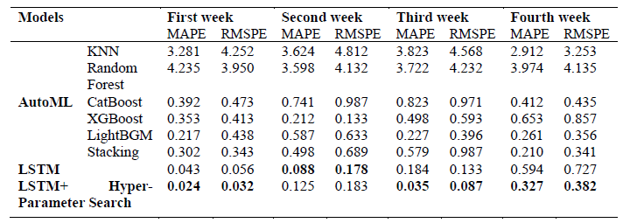
Why to use LSTM
Yun Dai and Jinghao Huang 2021
“The LSTM model with a special loss function and hyper-parameter search is proposed for overcoming challenges in the real-scene sales forecast. By comparing with traditional methods, we find that the proposed model is superior to others, which provide reliable predictions.”

Slide 6
Ignize goals
Annual revenue growth 5-10% in comparison to previous year

Slide 7
Exp 1: Region Business Area revenue forecast
LSTM | Value
Sequence Length | 12
Dropout | 15
Units | 100
Epochs | 200
Activation | tanh
Optimizer | Adam
Training data 48 month (2017-2020)
Validation set 12 month (2021)
Predict future values 12 (2022)
MinMaxscaler (0,1)
12 lagging window

Slide 8
Exp 1: Region Business Area revenue forecast
 | A00 - Equipment | B00 - LTC | F00 - GCCT
APAC | -11.70% | -8.63% | -18.25%
China | -77.15% | -11.92% | -29.83%
EMEA | -29.83% | -14.55% | 24.79%
Eurasia | 9.54% | -8.13% | -68.66%
India | -69.18% | -7.22% | -29.83%
Latin America | -48.55% | -23.82% | 2.80%
North America | 8.18% | -16.72% | -38.98%

Slide 9
Exp 2: Region: India Business Area: A00 - Equipment
LSTM | Value
Sequence Length | 12
Dropout | 2
Units | 25
Epochs | 50
Activation | mse
Optimizer | Adam
Training data 48 month (2017-2020)
Validation set 12 month (2021)
Predict future values 12 (2022)
StandardScaler()
12 lagging window

Slide 10
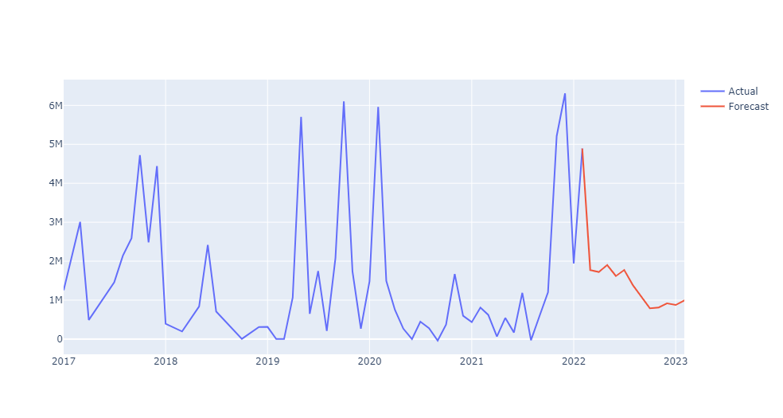
Exp 2: Region: India Business Area: A00 - Equipment
-9.62%

Slide 11
Region: India Business Area: A00 - Equipment
LSTM | Value
Sequence Length | 12
Dropout | 2
Units | 25
Epochs | 50
Activation | mse
Optimizer | Adam
Training data 48 month (2017-2020)
Validation set 12 month (2021)
Predict future values 12 (2022)
NO SCALER
12 lagging window

Slide 12
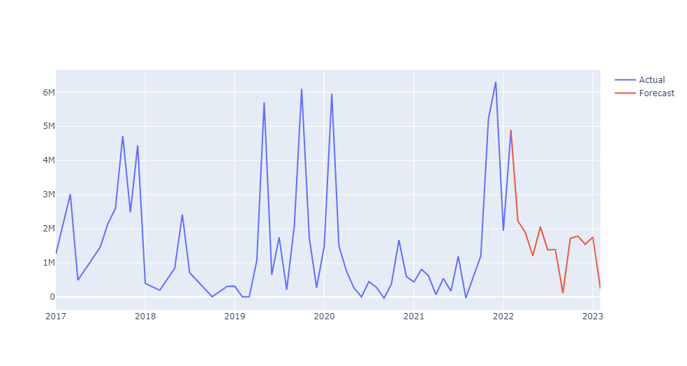
Exp 2: Region: India Business Area: A00 - Equipment
-2.39%

Slide 13
Region: India Business Area: A00 - Equipment
LSTM | Value
Sequence Length | 50
Dropout | 20
Units | 50
Epochs | 10
Activation | Mse
Optimizer | Adam
Training data 48 month (2017-2020)
Validation set 12 month (2021)
Predict future values 12 (2022)
StandardScaler()
Exogenous features

Slide 14
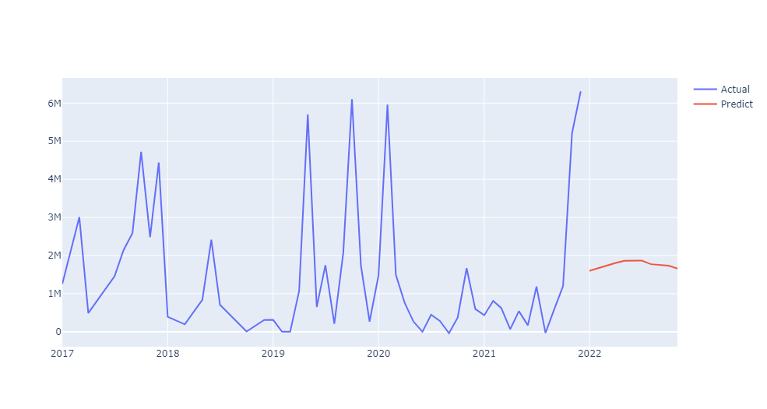
Exp 4: Region: India Business Area: A00 - Equipment
-2.39

Slide 15
Exp 4 :Commodity Index Forecast
commodity_index | 4.74% | palladium_index | 6.79%
copper_index | -3.39% | platinum_index | -18.26%
gold_index | -21.84% | silver_index | -19.17%
ironore_index | -60.40% | uranium_index | 0.99%
lead_index | 6.59% | zinc_index | -4.53%
molybdenum_index | -36.56%
nickel_index | -47.41%

Slide 16
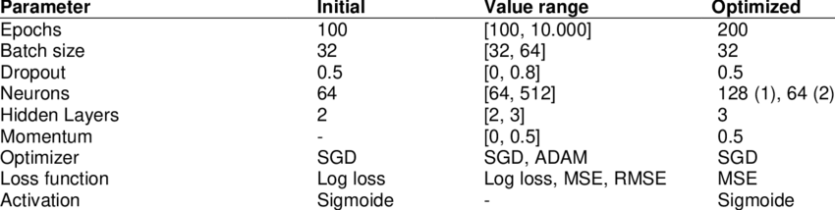
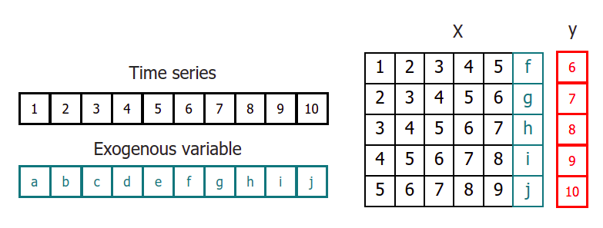
Next Steps
Using exogenous features
Hyperparameter tuning
Exogenous features for each business line? Macro indicators, commodities index?

Slide 17
Thank you
Igor Levecharov

